Slide 1

Non-Invasive point of care ECG signal detection and analytics for cardiac diseases
Bachelor of Technology
for the course
CL 498 Project II
Presented By
Shubham Kumar Gupta
Roll No. 180107058
Under supervision of
Assistant Professor Resmi Suresh
Professor Dipankar Bandyopadhyay

Slide 2
Content
Objective
Electrocardiogram (ECG)
Working Principle of ECG
Case Study
Circuit & Block Diagram
Electrically Conductive Surface
Dataset Refining
Dataset Modelling
Results and Discussion
Conclusion
References

Slide 3
Objective
Acquire information about the ECG and its working
Analyze different product in the market (like Apple's ECG watch and Sanket's 12 Lead ECG), and to analyze what limitations, constraints and issues remain and how we may come up with a better solution with some enhancement.
Work on sample dataset, predict variety of diseases related to the heart especially Atrial Fibrillation
Develop our portable, noninvasive point-of-care system for monitoring ECG levels using micro pattern electrode like Conductive Hook & Loop or Silicone Rubber Electrode.
Collect our own datasets.
Simultaneously apply detection model over the ECG recorded data.
Two way communication between device and smartphone
Cloud Analysis

Slide 4
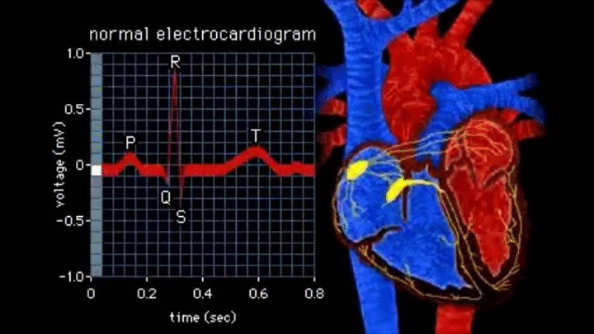
Electrocardiogram (ECG)
Electrocardiogram records electrical signals in heart. Common and painless test to quickly detect heart problems.
Using electrodes, ECG records heart's electrical activity by putting electrodes at various points on the body.
Electrocardiogram can be used to detect:
Abnormal heart rhythm (arrhythmias)
If blocked or narrowed arteries
Proper check on working of pacemaker
ECG is plotted on a graph paper in which 1mm corresponds to 0.04s on the x-axis and 0.1mV on the y-axis
ECG Recording

Slide 5
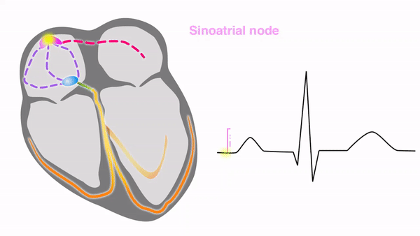
Electrocardiogram (ECG)
SA Node to Atria​
Electrical discharge for cardiac cycle starts in special area of right atrium called ‘sinoatrial (SA) node’​ (natural pacemaker).
It initiates all heartbeat and determines heart rate. Impulses from SA node spread throughout both internodal atrial pathway via atria and stimulate them to contract.​
Depolarization then spreads through atrial muscle fibers. ​
AV Node to Bundles​
There is delay while depolarization spreads through another special area in atrium, ‘atrioventricular (AV) node’. ​
Located near AV valve. Signals passed to bundle of His.​
This bundle is divided into right and left bundle branches which conduct impulses toward apex of heart. ​
Bundles to Purkinje fiber​
Signals are then passed onto Purkinje fibers, turning upward and spreading throughout ventricular myocardium.​
Repolarization occurs​
Path Tracing of an ECG
Source: sciencedirect.com

Slide 6
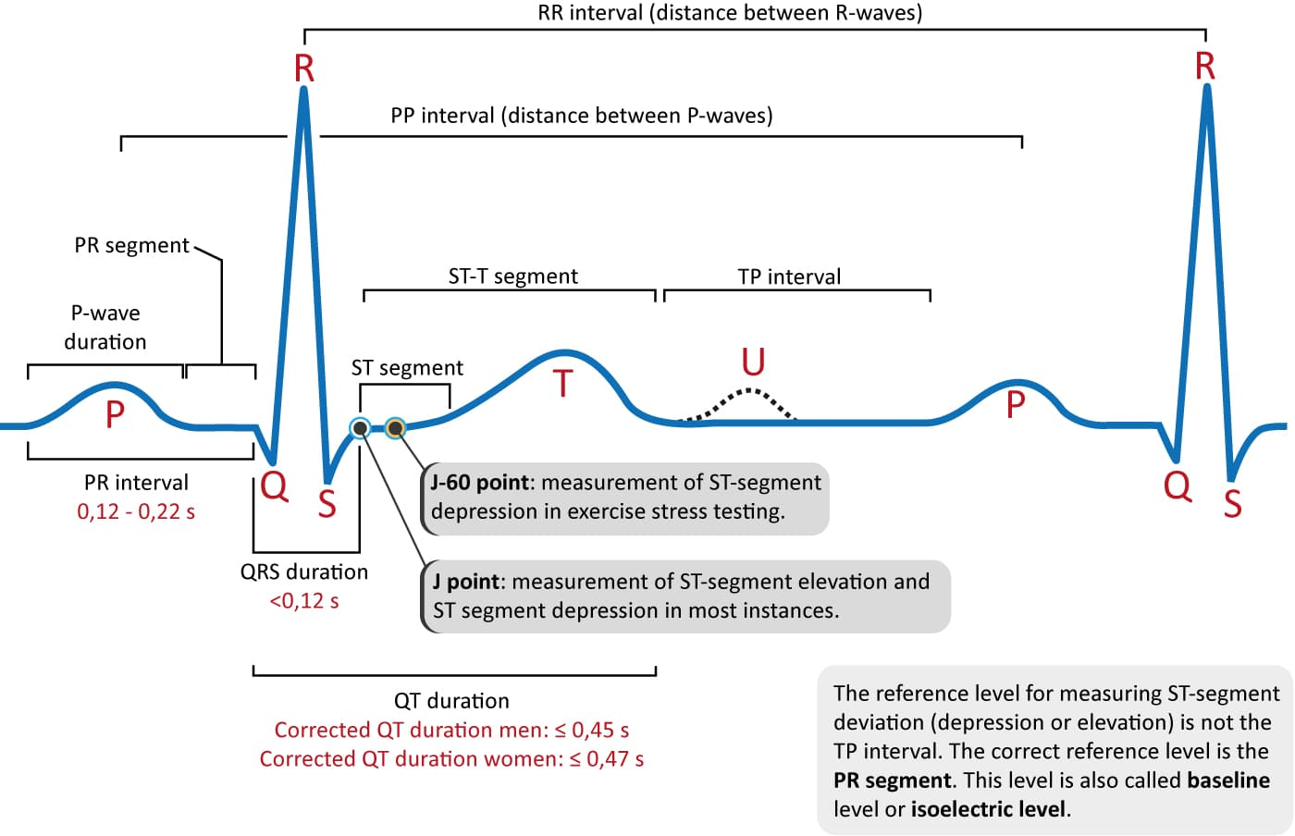
Electrocardiogram (ECG)
ECG waves and intervals are classified as
P-wave and PR interval
P wave is indicative of atrial depolarization (activation).
PR interval is time period between P-wave and QRS complex, used to assess normality of impulse conduction from atria to ventricles.
QRS Complex
It shows ventricles depolarizing and reflection of left ventricular depolarization because electrical vector generated by left ventricle that is bigger than electrical vector generated by right ventricle.
J-wave and ST segment
ST segment is particularly relevant in acute myocardial ischemia because ischemia results in deviation.
J point denotes commencement of ST segment.
T-wave and U-wave
T-wave indicates contractile cells' rapid repolarization and occur under wide variety of situations.
U-wave is +ve wave that occurs immediately following T-wave, about ¼th that of T-wave.
ECG wave segments
Source: ecgwaves.com

Slide 7
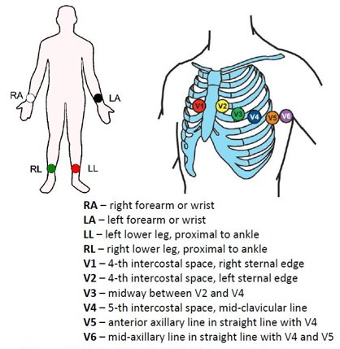
Electrocardiogram (ECG)
To take ECG with 12 leads, electrodes are placed over body​
Uses only 10 electrodes, some electrodes are part of two pairs and provide two leads. ​
Electrodes typically are self-adhesive pads with conducting gel in center. Electrodes snap onto cables connected to electrocardiograph or heart monitor.​
E.C.G Gel improves conductivity between skin and heart rate monitor electrodes. ​
Unipolar Leads (single conductor lead)​
Augmented Limb Leads (aVL, aVF, aVR) one limb is +ve and other two as zero.
Chest Leads are +ve poles
Bipolar Leads (2 separate conductors within a single-lead)​
Leads I, II, and III measure electrical potential between 2 of the 3 limb electrodes:​
12 Leads ECG electrode placement
Source:aimcardio.com

Slide 8
Electrocardiogram (ECG)
Muscular walls in each chamber of heart contract in a coordinated sequence
When an individual's heart rhythm is aberrant, this is called abnormal cardiac rhythms. It occurs when an individual's heart electrical system malfunctions or fails to perform properly.
Arrhythmias caused by irritable cardiac cells, blocked signals, aberrant routes, medications and stimulants, and coronary arteries spasms.
When heart rate is excessively rapid (tachycardia) or sluggish (bradycardia) that cardiac rhythm is considered abnormal.
People are unaware of irregular cardiac rhythms, they frequently only feel their repercussions, such as weakness or fainting.

Slide 9
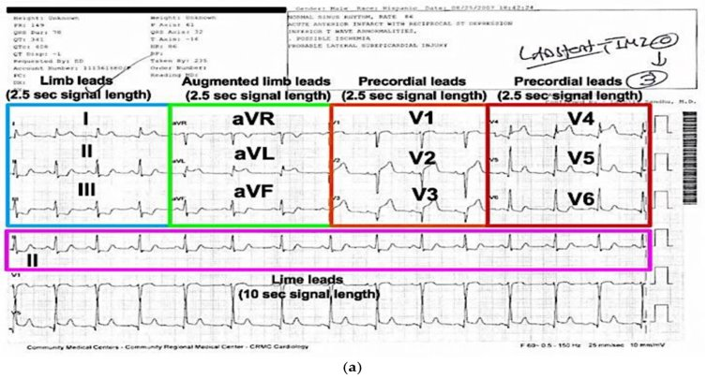
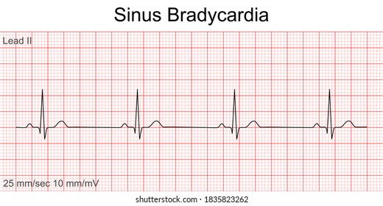
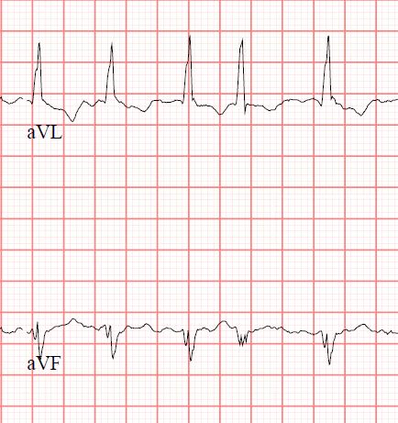
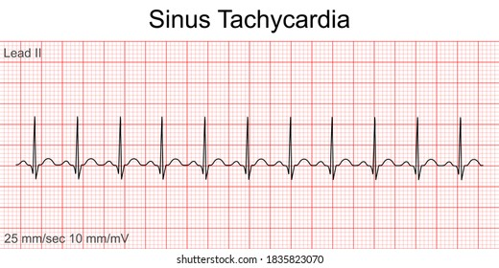
Electrocardiogram (ECG)
Tachycardia
Source:heart.org
Atrial Fibrillation
Source:heart.org
Sample ECG Recording
Source: oxfordmedicaleducation.com
Bradycardia
Source:heart.org

Slide 10
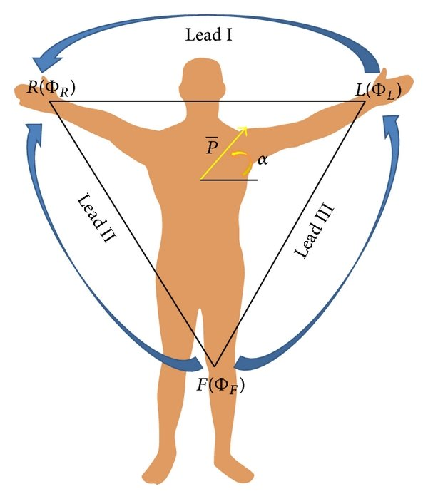
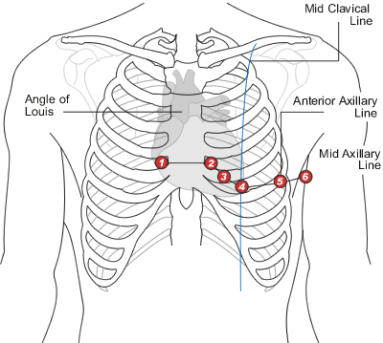
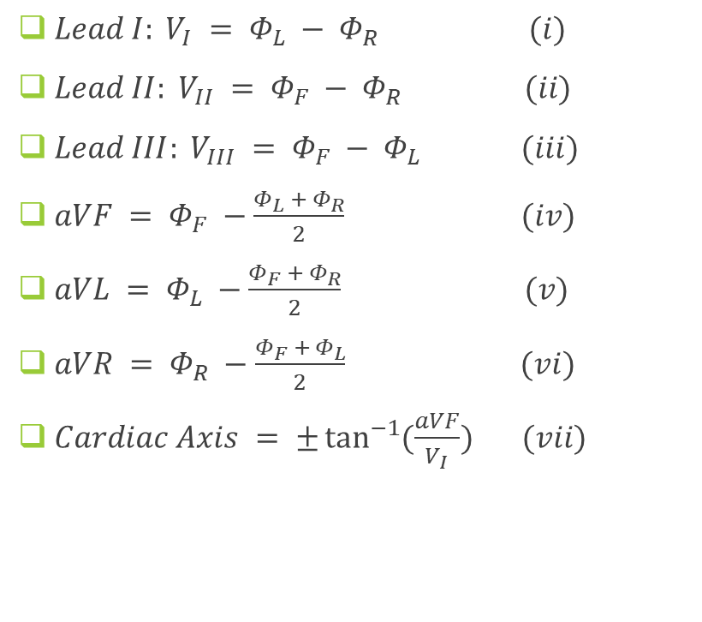
Working Principle
$Lead I: V_{I} = Φ_{L} − Φ_{R} (i)$
$Lead II: V_{II} = Φ_{F} − Φ_{R} (ii)$
$Lead III: V_{III} = Φ_{F} − Φ_{L} (iii)$
$aVF = Φ_{F} −\frac{Φ_{L} + Φ_{R}}{2}$ $(iv)$
$aVL = Φ_{L} −\frac{Φ_{F} + Φ_{R}}{2}$ $(v)$
$aVR = Φ_{R} −\frac{Φ_{F} + Φ_{L}}{2}$ $(vi)$
$Cardiac Axis = ±\tan^{−1}{(\frac{aVF}{V_{I}})} (vii)$
ECG Electrode placement and potential
Source:aimcardio.com

Slide 11
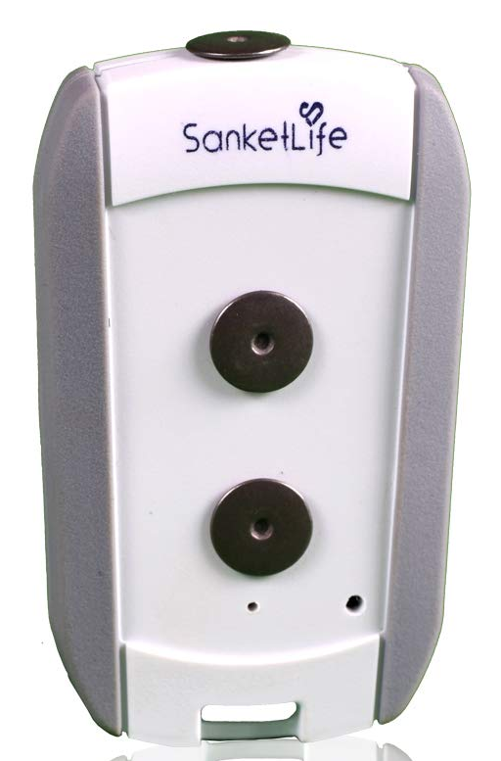
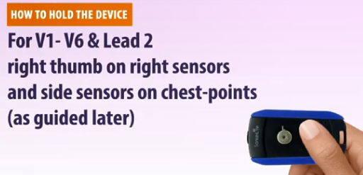
Case Study (Sanket’s 12 Lead ECG)
Pros
Sanket's ECG is small portable ECG device that is widely used in rural markets.
Cheap and no need for additional wired electrode placements.
Can record 12 Lead ECG signal
Has total of 2 electrode contact point system, which are touched at different body parts to get a single lead ECG
Completing different circuits we can get all 12 Leads ECG using it
Cons
Needs assistance of a medical practitioner to use it
Misplacement of electrode may result in improper results
Better noise deduction can be obtained
Sanket’s 12Lead ECG
Source:sanketlife.in

Slide 12
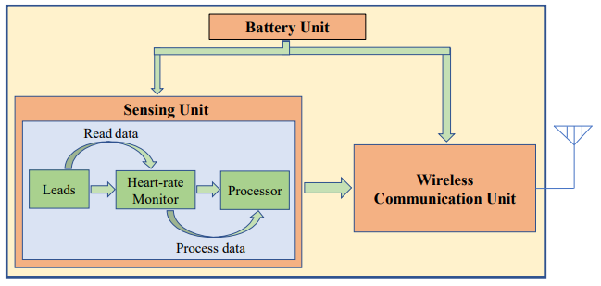
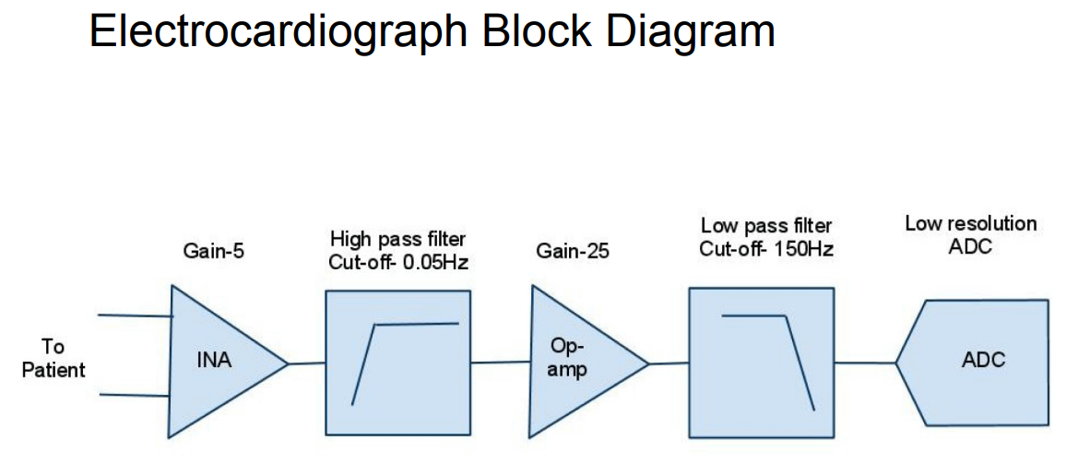
Circuit & Block Diagram
It should contain total of three units:
Battery Unit (Power Source)
Sensing Unit
Wireless Communication Unit
Sensing Unit
Capture leads
Monitor heart rate
Process them like passing wave via various electrical circuits like amplifier or band pass filters, and denoising the final output signal
Then Analog signals are converted to digital signals and sent to Wireless Unit
Wireless Communication Unit
Output data generated from sensing unit should be transferred to mobile application using the wireless may be wifi/Bluetooth/internet cloud channels
Block Diagram of a ECG device
Source: Mobile-based Tele-ECG for rural health care

Slide 13
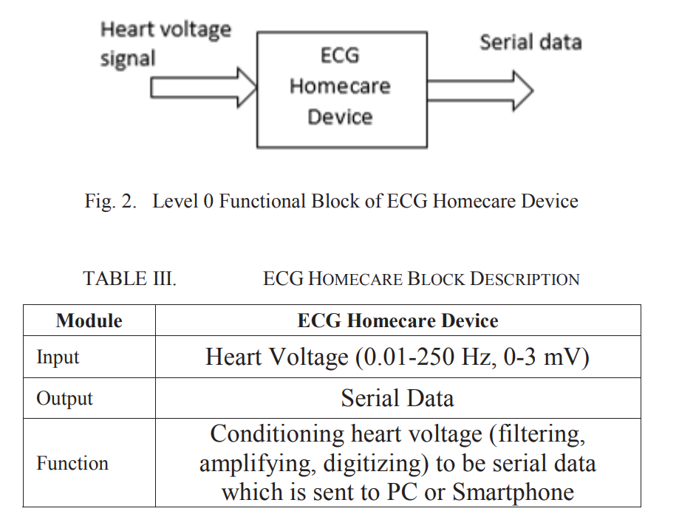
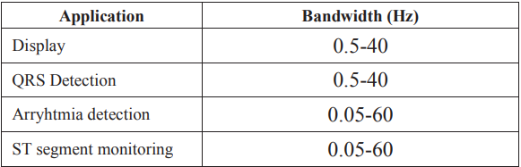
Circuit & Block Diagram
Input analog signal contains electrical output from heart with voltage range ~ 0-3 mV and frequency range ~ 0.01-250 Hz
Output signal contains digital serialized data converted from analog signals.
Process can be done on ECG device , process like filtering, amplifying and digitalizing can be done and will be sent to PC or smartphone device
Further processing can be done to detect and predict from different wave signals like QRS detection requires Bandwidth of 0.5Hz to 40Hz and arrythmia is detected with 0.05 Hz to 60Hz
Source:Design_of_ECG_Homecare12-lead_ECG, IEEE

Slide 14
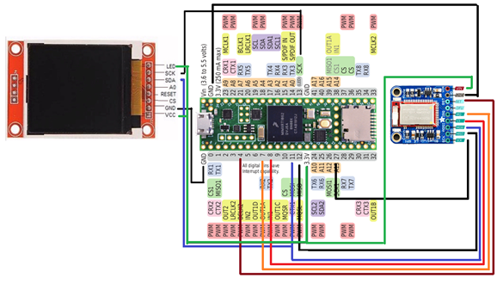
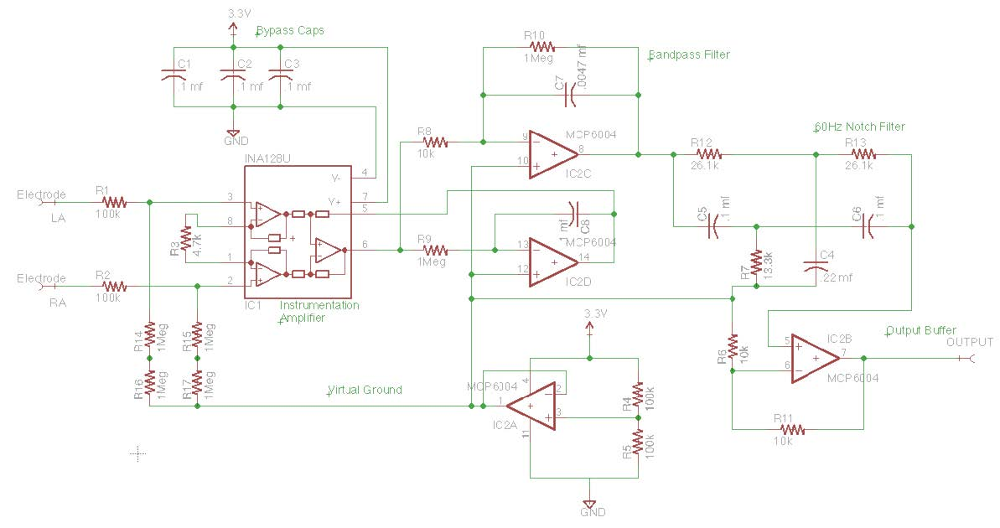
Circuit & Block Diagram
Circuit Diagram
Source: CSE 474 courses.cs.washington.edu
Circuit Diagram

Slide 15
Circuit & Block Diagram
Total of 2 electrode system
When touched at different body parts using electrodes circuit completes and single lead ECG is recorded
Completing different circuits we can get all 12 Leads ECG using it
Circuit contains electrodes, a bypass capacitor (removes DC noise), amplifier (to amplify lower signals), bandpass filter circuit and a notch filter to remove noise and tune the ECG recording
Circuit Diagram
Source: CSE 474 courses.cs.washington.edu

Slide 16
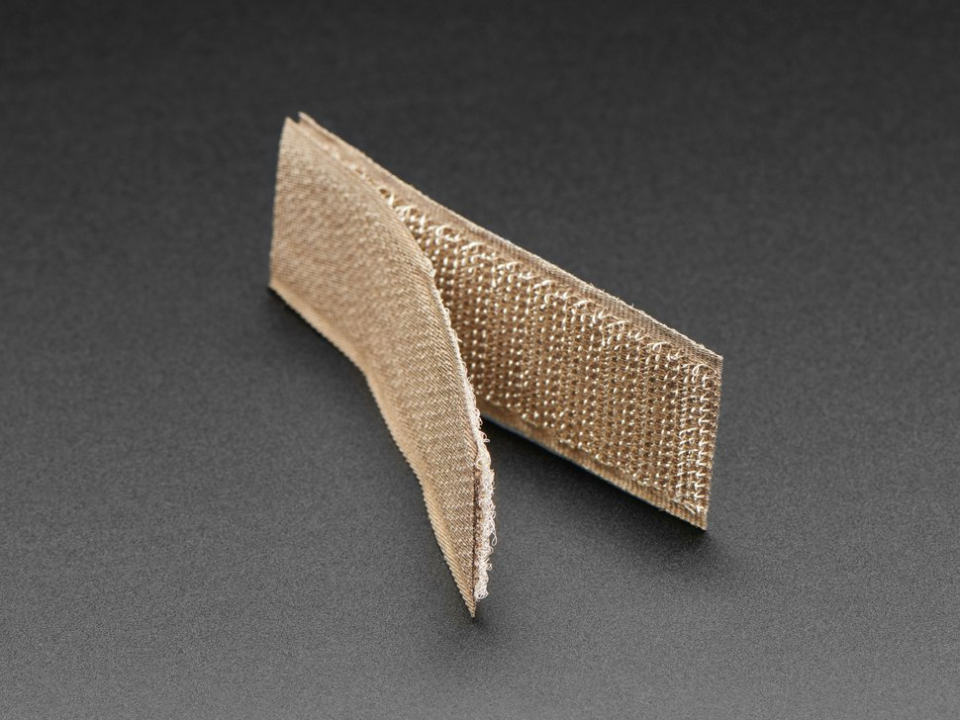
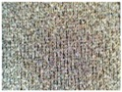
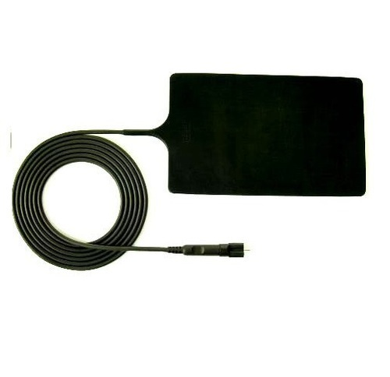
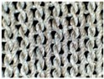
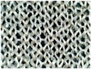
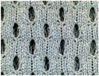
Electrically Conductive Surface
Electrode Materials |  | Components | Structure | Fabric Thickness (mm) | Yarn Diameter (mm) | Wales/cm | Courses/cm
TE1 |  | 78% silver plated nylon 66 + 22% Elastomer | Weft knitted | 0.45 ± 10% | 0.13 ± 20% | 28/cm | 30/cm
TE2 |  | 100% silver plated nylon 66 | Weft knitted | 1.25 ± 10% | 0.60 ± 20% | 5/cm | 6/cm
TE3 |  | 100% silver plated nylon 66 | Weft knitted | 0.70 ± 10% | 0.30 ± 20% | 8/cm | 12/cm
TE4 |  | 94% silver plated nylon 66 + 6% elastomer | Weft knitted 3D spacer | 2.50 ± 10% | 0.18 ± 20% | 17/cm | 28/cm
 |  |  |  |  |  | (surface) | (surface)
Conductive Hook & Loop
Resistivity: 1.4 Ohm per sq inch
Electrically conductive Silicone Rubber Sheet
Resistivity: 1.57 to 3.14 Ohm per sq inch
Avg : 2.35 Ohm per sq inch
A Hybrid Textile Electrode for Electrocardiogram (ECG) Measurement and Motion Tracking (nih.gov)
Conductive Hook & Loop Tape - 3" long - Thingbits Electronics
Electrically Conductive Silicone Rubber Sheet, Thickness: 1.6 to 3.2 mm, Rs 125 /meter | ID: 16623200873 (indiamart.com)

Slide 17
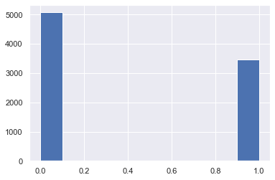
Dataset Refining
Taken a sample dataset from “AliveCor's Short Single Lead ECG Recording” dataset (short 2000ms ECG Amplitude data)
Dataset contained 2001 columns and 8530 rows after removing null data points
Columns from 1st to 2000th are time in mili seconds and 2001th column is string labeled column as Normal or Atrial Fibrillation datapoints.
Each Row denotes Amplitudes value in mV taken at different time frames and labeled as Normal or Abnormal
Converted the label column to 0 (normal) and 1 (atrial fibrillation).
Skewness check was done by plotting histogram on counts of occurrence of 0(58% dataset) and 1.
Shuffled the dataset and divided it into training and validation testing.
Histogram showing Normal and Abnormal datapoints

Slide 18
Dataset Modelling
Time Signals | 0 | 1 | 2 | 3 | 4 | 5 | 6 … | 1999 | Label
Row 1 | 0.035032 | 0.037155 | 0.044586 | 0.063694 | 0.076433 | 0.085987 | 0.089172 | -0.02229 | Normal
Row 2 | -0.03529 | -0.03257 | -0.03094 | -0.02986 | -0.03149 | -0.0342 | -0.03746 | 0.001086 | Normal
Row 3 | -0.30392 | -0.26144 | -0.22222 | -0.19281 | -0.17647 | -0.1634 | -0.14706 | -0.06536 | Normal
Row 4 | 0.109467 | 0.117604 | 0.128698 | 0.142012 | 0.153107 | 0.161982 | 0.170118 | 0.013314 | Abnormal
Row 5 | -0.01986 | -0.01715 | -0.01444 | -0.01173 | -0.00993 | -0.00812 | -0.00632 | 0 | Abnormal
Row 6 | 0.051136 | 0.0625 | 0.090909 | 0.142045 | 0.238636 | 0.335227 | 0.4375 | 0.119318 | Normal
Row 7 | -0.12387 | -0.12991 | -0.13595 | -0.14804 | -0.16012 | -0.17221 | -0.18429 | 0.253776 | Normal
Row 8 | -0.04615 | -0.0441 | -0.04205 | -0.03897 | -0.0359 | -0.03179 | -0.02769 | 0.019487 | Abnormal
Row 9 | -0.02503 | -0.02503 | -0.02253 | -0.01877 | -0.01126 | 0.001252 | 0.017522 | -0.0776 | Abnormal
Table 1 Sample ECG Alivecor short single lead dataset

Slide 19
Dataset Modelling
From dataset, there is no correlation between any two columns and every column is important
Our features are the time valued columns with equal weights and labelled column as out predicting column.
Each row seems as an image matrix so this seemed as an image classification problem
To predict image we chose to build a Convolution Neural Network model
As CNN works better in a sharp object and edge detections techniques.
Single Row ECG Plot

Slide 20
Dataset Modelling
Each row is represented as 1D matrix of an ECG image .
Divided dataset into 80% as training and 20% as testing set.
Chose kernel size (length of one-dimensional convolution window) as 5.
Filter size (output space's dimensionality). As we need to check different parts of the image searching for datapoints.
Input layer shape for ConvNet: (2000x1).
Model consists of 8 ConvNet hidden layers (ReLu),1 flattened output layer (linear) and performed max pooling, dropouts for those layers and then dense layer is created.
Max pooling is used to get maximum value in each patch of feature map, highlights most abundant feature in patch.
Use of dropouts, where randomly chosen neurons are ignored during training, their contribution to activation of downstream neurons is removed temporally during forward trip, and any weight modifications to neuron are skipped during backward pass.
Utilized Adam Optimizer with learning rate of 0.00006, with total of 100 epochs, batch size of 128 and validation split of 0.2
On the basis of loss, accuracy, precision, we evaluated our model, using python libraries of TensorFlow, Keras and Scikit-Learn

Slide 21
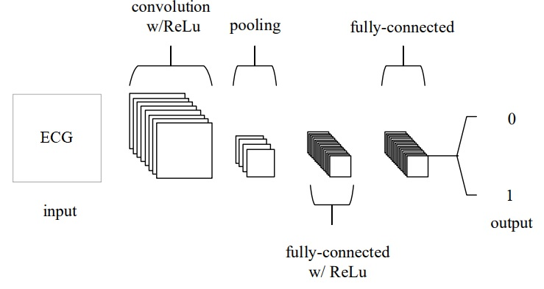
Dataset Modelling
Convolution Neural Network

Slide 22
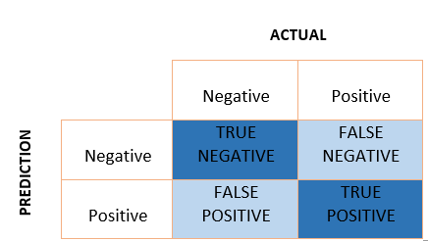
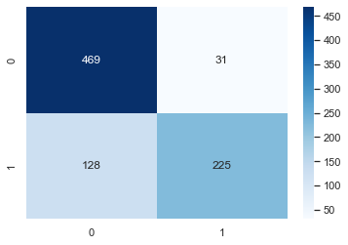
Results and Discussion
To better represent normal and abnormal ECGs, we renamed the designated column 0 and 1
Determining that dataset is not skewed.
Built a deep learning Convolution Neural Network (CNN) model with 100 epochs and 128 batch size.
Assessed the model over the dataset after fitting, was able to get an 81.36 % accuracy and loss about 28.8%
Constructed the confusion matrix and estimated the precision, recall, and F1 score.
Confusion Matrix

Slide 23
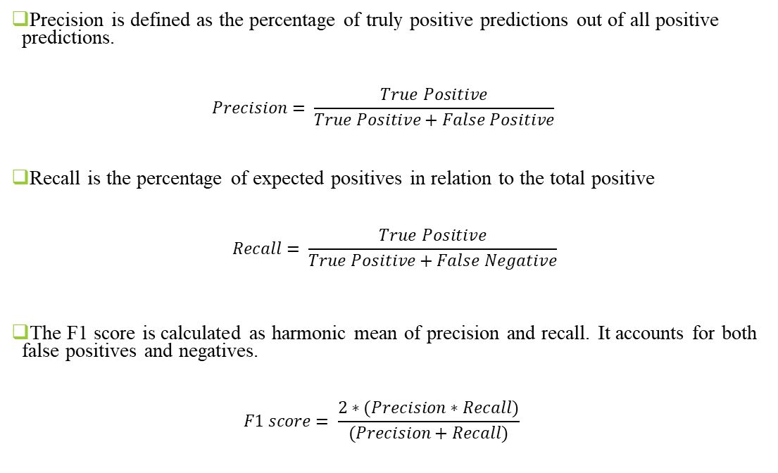
Results and Discussion
Precision is defined as the percentage of truly positive predictions out of all positive predictions.
$$Precision= \frac{True Positive}{True Positive+False Positive}$$
Recall is the percentage of expected positives in relation to the total positive
$$Recall= \frac{True Positive}{True Positive+False Negative}$$
The F1 score is calculated as harmonic mean of precision and recall. It accounts for both false positives and negatives.
$$F1 score= \frac{2∗(Precision∗Recall)}{(Precision+Recall)}$$
 | Precision | Recall | F1 score
Normal | 0.79 | 0.94 | 0.86
Atrial Fibrillation | 0.88 | 0.64 | 0.74
Table 2 Precision, Recall, F1 score

Slide 24
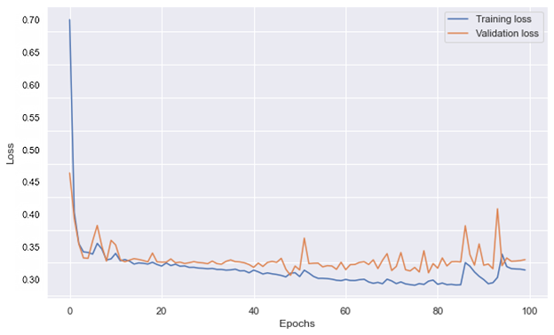
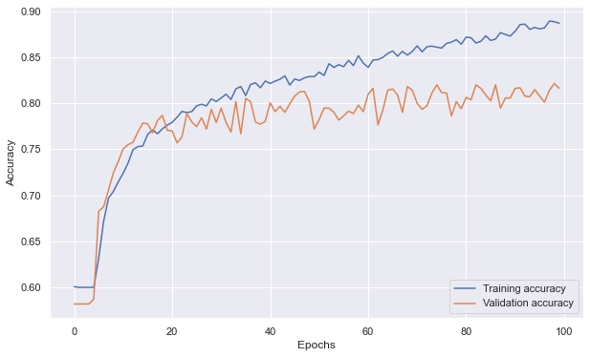
Results and Discussion
Loss v/s Epochs for Training Loss and Validation Loss
Accuracy v/s Epochs for Training Accuracy and Validation Accuracy

Slide 25
Conclusion
Learned how our hearts operate and how an ECG works, and risk factors can detected using an ECG.
Analyzed products available in market, and need of making move from traditional to cheap portable devices.
Analyzed about procedures of taking an traditional ECG.
Studied parts of ECG waves and different sections like P-wave, QRS-complex, T-wave, etc.
Studied how a 1D convolutional neural network model can be built and how it can be used to effectively predict Atrial Fibrillation.
Measure of accuracy, precision and recall of our model and got accuracy of about 81.36% and loss of about 28.8%
We implemented the circuit design and built a basic device, we faced error while soldering the steel plate and problem related to higher version of teensy programmable chip which lacked Programmable Delay Box hardware unit leading to issue on using libraries related to ADC conversion and small input reads.
Learnt about micropattern electrodes, which can be used to improve the accuracy, grip and precision.
Following this, we can proceed for a marketable portable, point-of-care non-invasive ECG device setup and own data collection.

Slide 26
References
Design of ECG Homecare:12-Lead ECG Acquisition using Single Channel ECG Device Developed on AD8232 Analog Front End
Accessing the ECG Data of the Apple Watch and Accomplishing Interoperability Through FHIR (researchgate.net)
Taking an ECG with the ECG app on Apple Watch Series 4, Series 5, or Series 6 - Apple Support (IN)
CSE 466 Lab 7: Analog Front End for an Electrocardiograph (washington.edu)
CSE466 lectures (washington.edu)
True Unipolar ECG Machine for Wilson Central Terminal Measurements (researchgate.net)
A Novel Wearable Device for Continuous Ambulatory ECG Recording: Proof of Concept and Assessment of Signal Quality (nih.gov)
Electronics | Free Full-Text | Advances of ECG Sensors from Hardware, Software and Format Interoperability Perspectives (mdpi.com)
Comparison of Baseline Wander Removal Techniques considering the Preservation of ST Changes in the Ischemic ECG: A Simulation Study (hindawi.com)
Passive Detection of Atrial Fibrillation Using a Commercially Available Smartwatch | Atrial Fibrillation | JAMA Cardiology | JAMA Network
Comparison of Baseline Wander Removal Techniques considering the Preservation of ST Changes in the Ischemic ECG: A Simulation Study (hindawi.com)

